Slide 1

Rideshare App
Done By:
Blein Yirdaw
Gilbert Ssebadduka
Mekuanenet Anteneh
Thierry Manzi

Slide 2
Agenda
Designing and Implementing an Android Mobile Application(RideSharing App), which connects drivers and passengers for an effective, efficient and convenient passenger traveling experience.

Slide 3
Objective
This project provides a platform where riders (people who owns cars) and travelers (people who needs transportation service) can have exchange trip related information. It has a paramount importance for those who can’t afford expensive long trips, such as students.
Helping people to travel cost effectively as well as to cover their fuel cost.
Passengers will benefit from RideSharing application by finding rides with the same destination as theirs, at the same time drivers will no longer have to travel long distances with empty seats.
Drivers just share their journey with passengers & travel economically.

Slide 4
Advantages
Reduces the number of single driver cars on the road
Reduces smog, congestion and fuel consumption.
Saves fuel - positive effect on the whole economy
Increases social interaction
Creates opportunities for increasing social capital

Slide 5
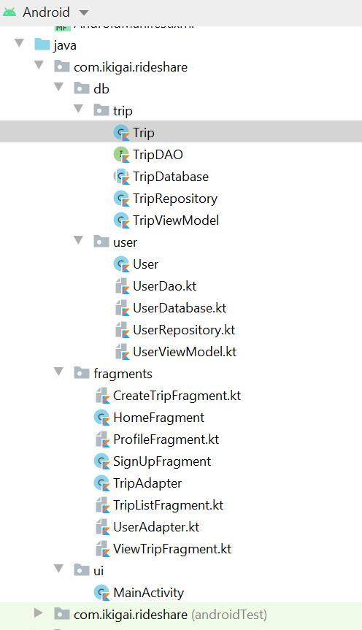
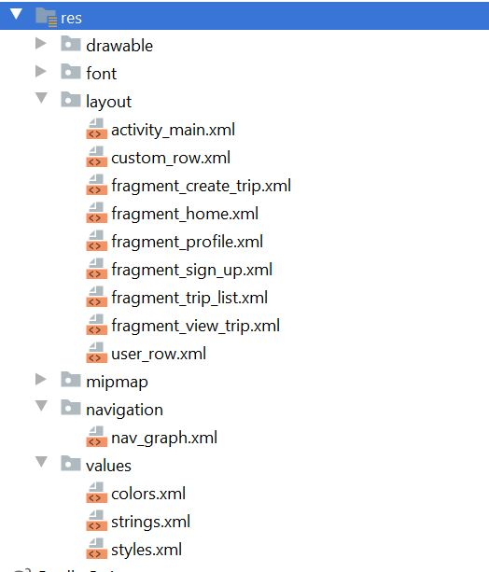
Application Structure
Java Folder
Resources Folder

Slide 6
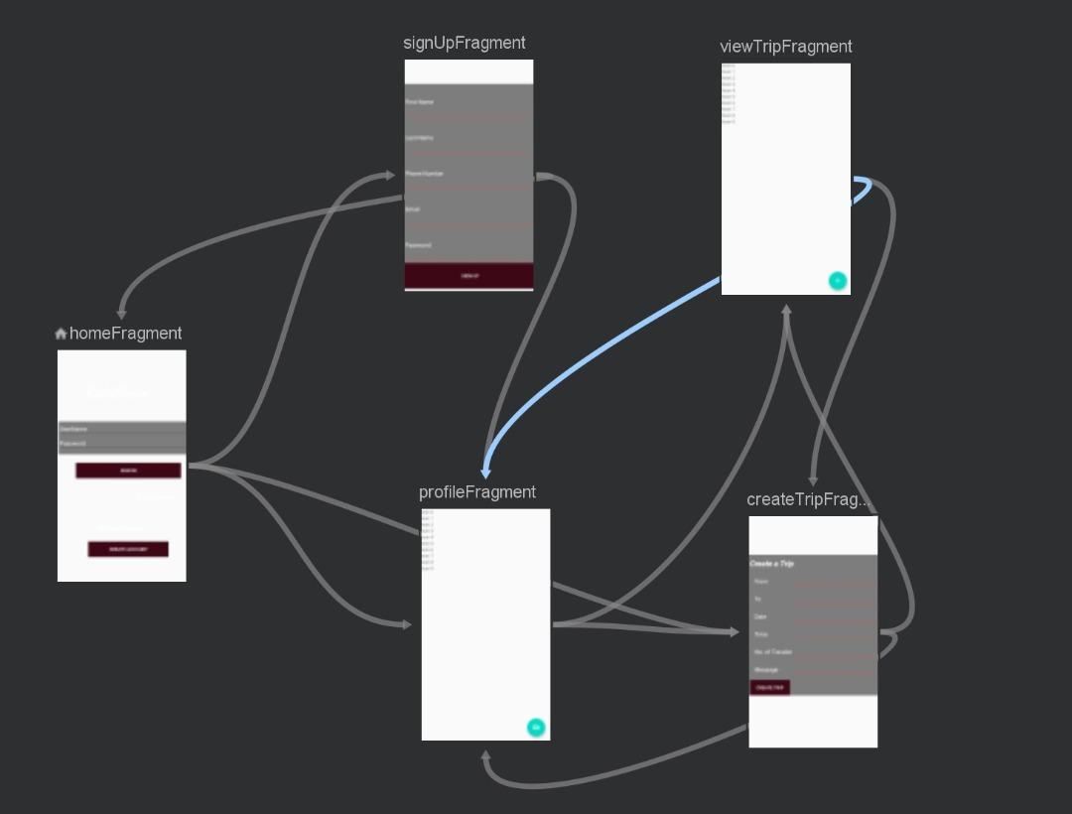
Application Structure
Fragments Design

Slide 7
Features
User Registration: A user without an account can create an account by signing up and their information is saved to the database.
User sign-in: A user with an account can sign-in using his/her credentials added during User Registration.
User Profile: A signed in user has access to his/her user profile/credentials and may choose to edit profile or go to other application features.
Available Trips: A signed-in user(passenger or rider) can check a list of available trips.
Request A Trip: if a user finds a trip that matches his/her destination, they can click on it and get the contact of the person who added that trip and connect.
Add A Trip: If a user doesn’t find a trip matching his/her destination, they can add a new trip.

Slide 8
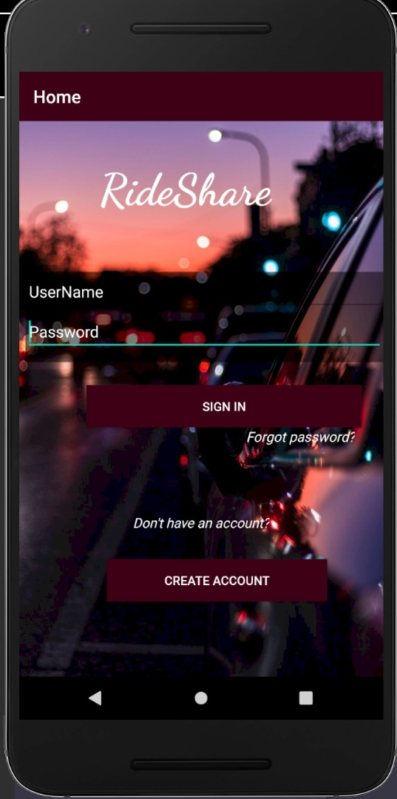
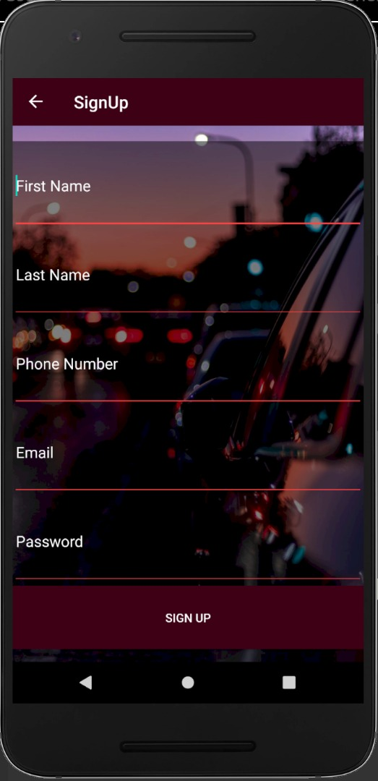
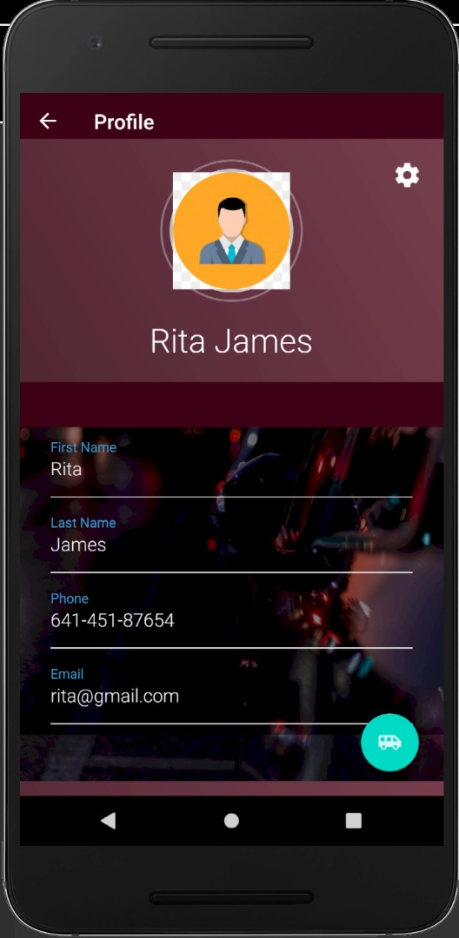
Features
Home Page
Sign Up Page
User Profile Page

Slide 9
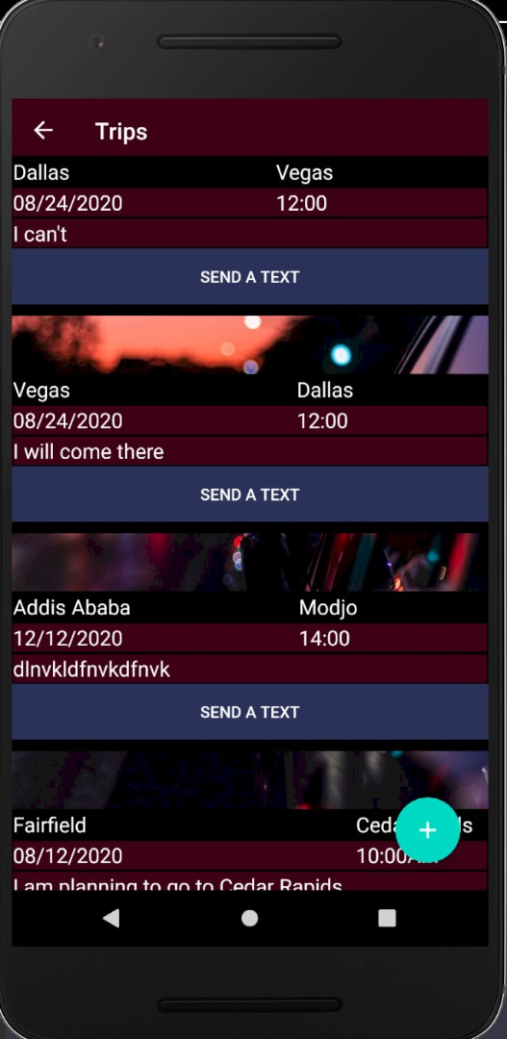
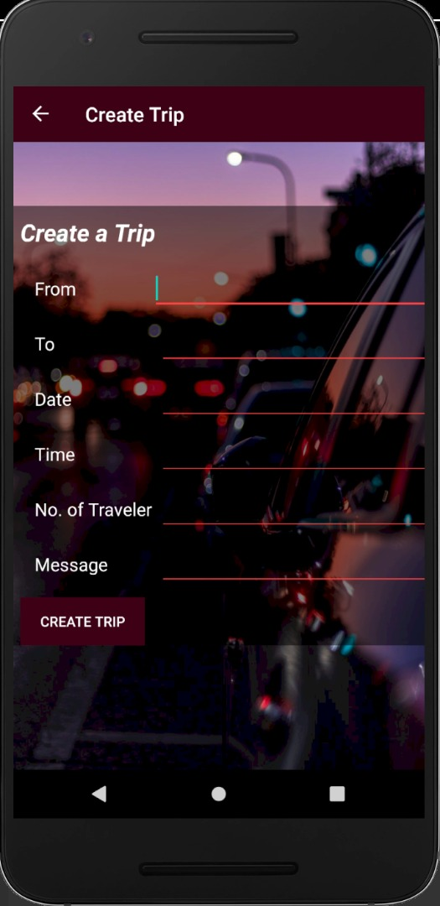
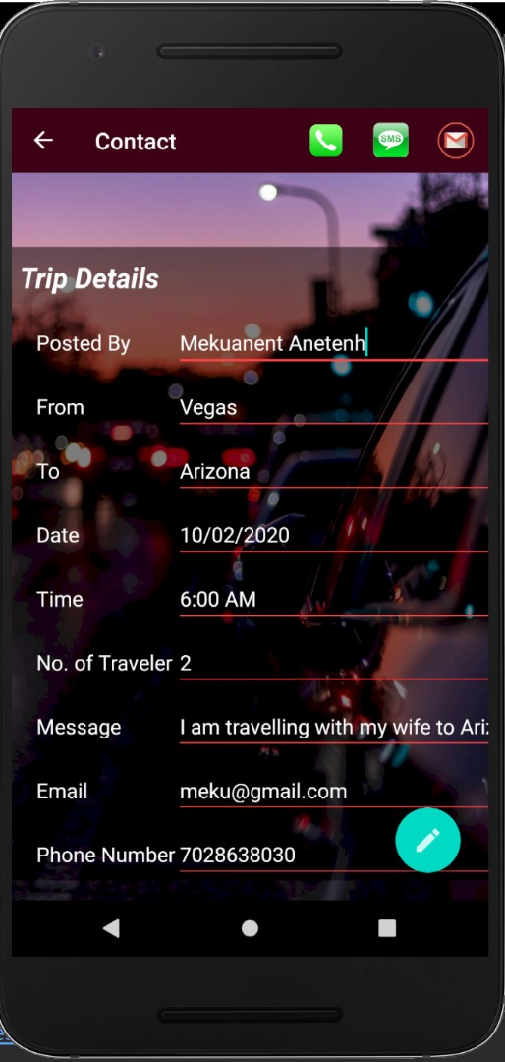
Features
Available Trips
Create a Trip
Trip Details

Slide 10
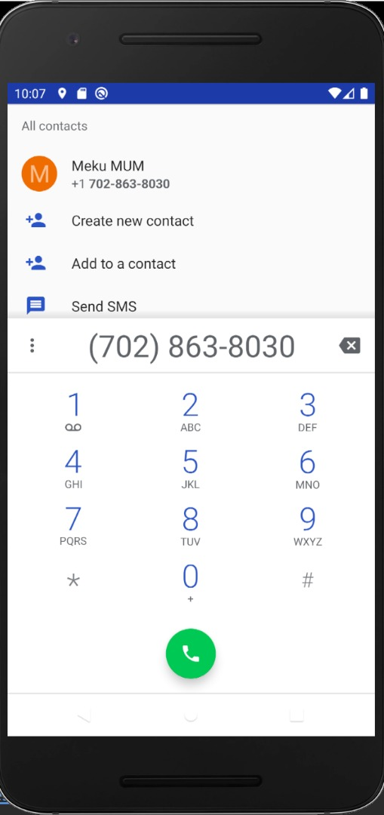
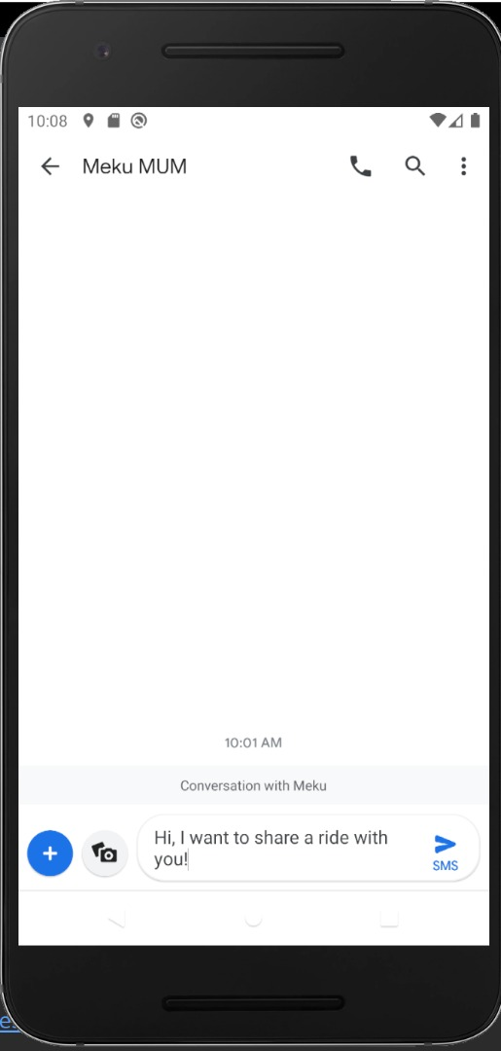
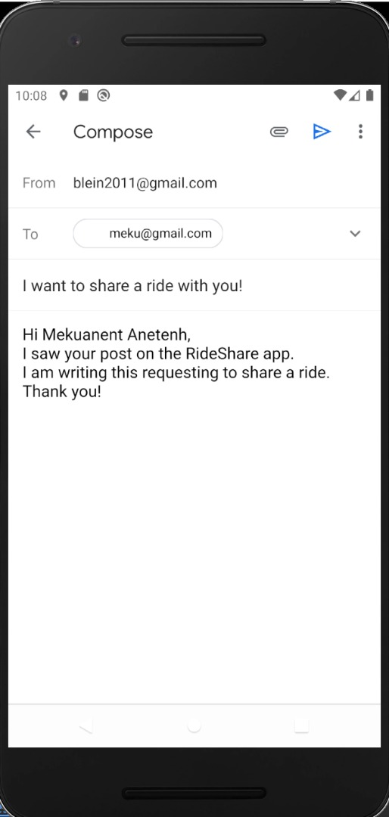
Features
Implicitly Call
Implicit SMS
Compose Email

Slide 11
Concepts Applied
Navigation Component
Recycler View
Room DB
Live Data
Observer
Coroutines

Slide 12
Dependencies Added On Gradle
//Navigation Component def nav_version = "2.3.0" implementation "androidx.navigation:navigation-fragment-ktx:$nav_version" implementation "androidx.navigation:navigation-ui-ktx:$nav_version" //Room Components def room_version = "2.2.5" implementation "androidx.room:room-runtime:$room_version" kapt "androidx.room:room-compiler:$room_version" // optional - Kotlin Extensions and Coroutines support for Room implementation "androidx.room:room-ktx:$room_version" // optional - Test helpers testImplementation "androidx.room:room-testing:$room_version" //Lifecycle Component implementation "androidx.lifecycle:lifecycle-extensions:2.2.0" implementation "androidx.lifecycle:lifecycle-common-java8:2.2.0" implementation "androidx.lifecycle:lifecycle-viewmodel-ktx:2.2.0" //Kotlin Components implementation "org.jetbrains.kotlin:kotlin-stdlib-jdk7:1.3.72" api "org.jetbrains.kotlinx:kotlinx-coroutines-core:1.3.7" api "org.jetbrains.kotlinx:kotlinx-coroutines-android:1.3.5"

Slide 13
Work assignment
Gilbert Ssebadduka
Preparation of rider’s and traveler's backend functionality including creation database schema for creating a user, sign-in , and user profile.
Project Documentation
Thierry Manzi
Preparation of rider’s and traveler's UI and ViewModel for creating a user, sign-in , and user profile.
Project Documentation
Mekuanenet Anteneh
Creating the project; creating the git repository
designing the landing page
preparation of trips UI and ViewModel
Blein Yirdaw
Team Lead
preparation of trips backend functionality including creation of database schema

Slide 14
GITHUB LINK
Project GitHub Link:
https://github.com/mekuanenet/RideShare

Slide 15
Main points
RideShare App serves as an interface that connects drivers and passengers. As a result, drivers can share their journey with passengers & travel economically. SCI point: The same as TM is a common interface to perform greater activities and taking right decision in life. Also helps to customize the individual and society needs in a better way.
RideShare App development featured a range of layers such as UI, Activities, Model, DAO and RoomDatabase. SCI point: Life is found in layers

